Slide 1






PDS
Computer Vision
CCNA Academic
CCNA 1, 2, 3, 4
@ P. Siagian
https://github.com/siagianp
https://www.youtube.com/@AmelOline/videos
https://github.com/amelcharolinesgn2/IoT_simulator-mqtt-NodeRed
https://github.com/amelcharolinesgn2/Cloud-Infrastructures
https://github.com/amelcharolinesgn2/ClouD-Infrastructure-SISKA-2025
https://github.com/amelcharolinesgn2/Gyroscope-Sensor-Data-Accelerometer
Notes:
Setting Up Ubuntu 20 Server on VirtualBox for Node.js App
https://github.com/NawalAShaltout/OS-02-/tree/main/Lab-03

Slide 3
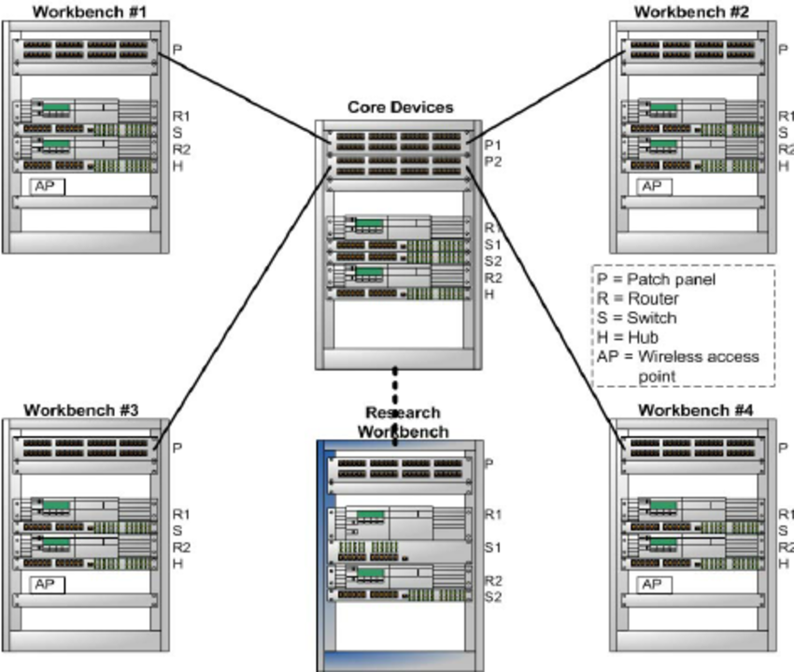
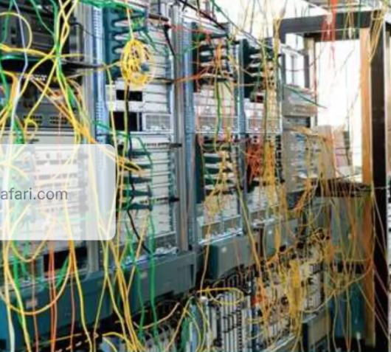
Networking

Slide 4
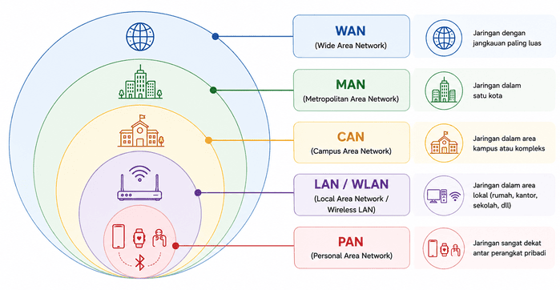

Slide 5
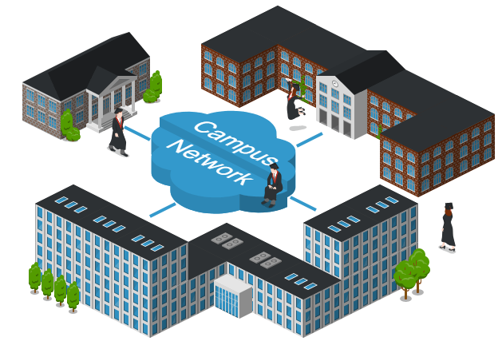
Networking

Slide 6
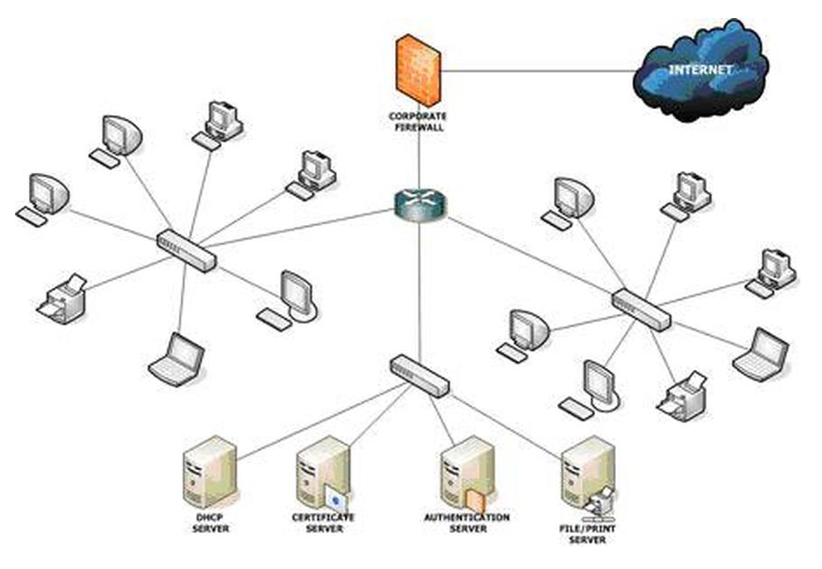
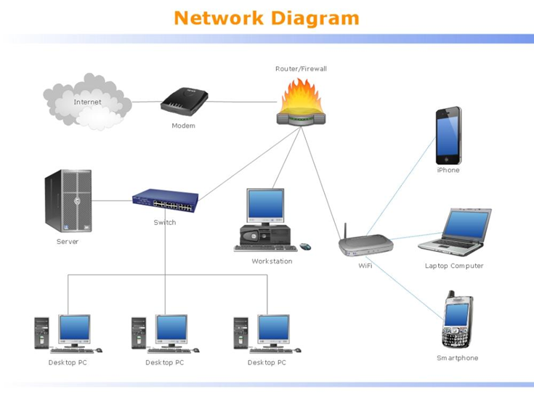
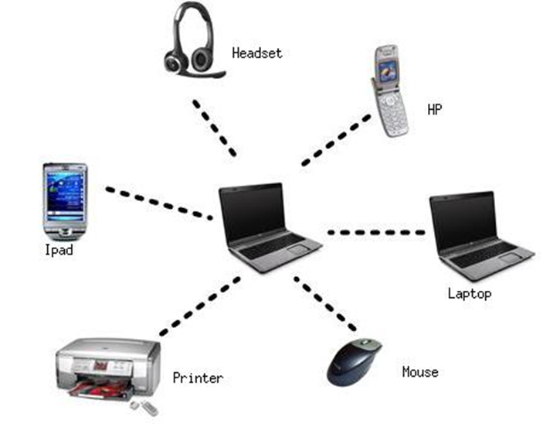
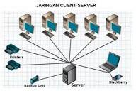
Networking
PAN (Personal Area Network)
LAN (Local Area Network)
WAN (Wide Area Network)
Notes:
https://www.idn.id/apa-itu-jaringan-pan-lan-man-dan-wan/
https://kingofnetworking.weebly.com/different-types-of-computer-networks.html

Slide 7
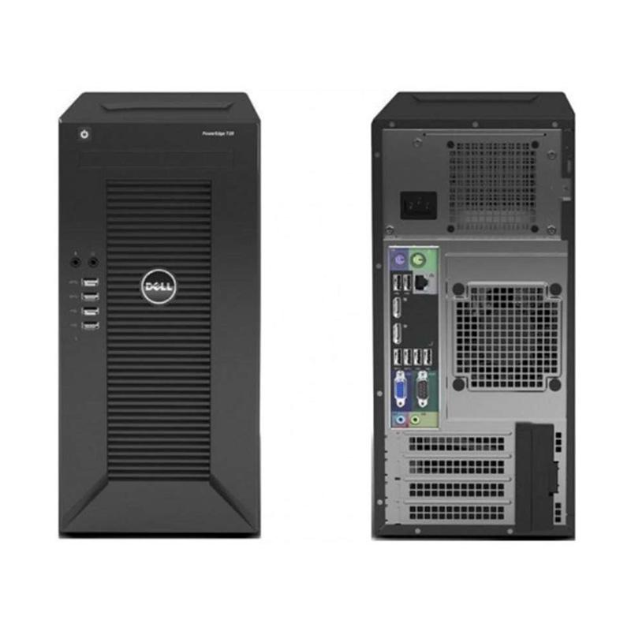

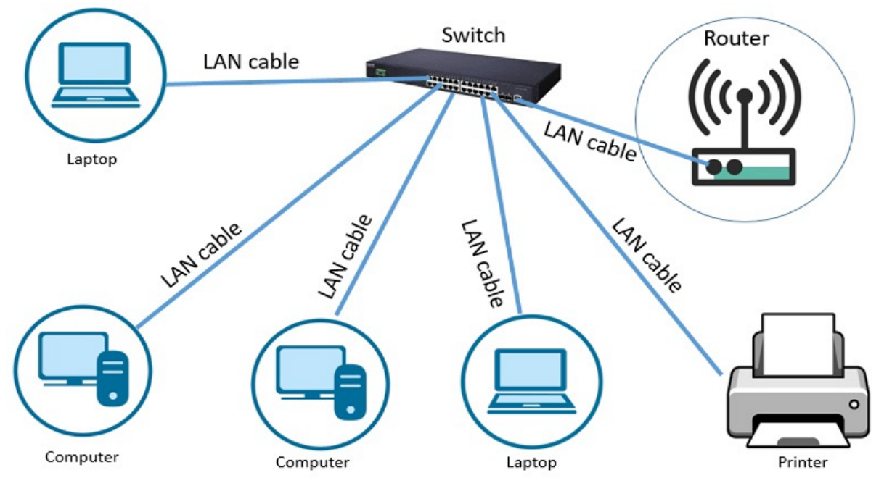
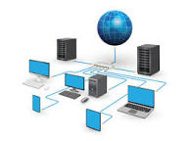
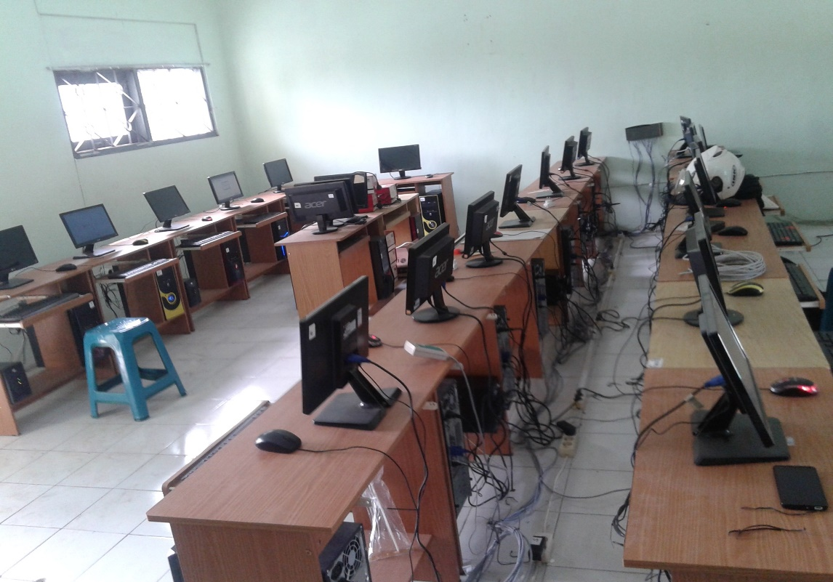
Networking
Server
Domain :
LAN
200.200.150.10
Sma2_library.sch.id
200.200.150.40
Barista_shop.com
192.168.100.5
192.168.100.10
192.168.100.12
192.168.100.18
192.168.100.15
192.168.100.20
Notes:
https://catatanteknisi.com/apa-itu-jaringan-komputer/
https://makassarstore.co.id/keuntungan-jaringan-local-area-network/
https://networking.indo-solution.com/cara-membangun-jaringan-lan-untuk-lab-sekolah/

Slide 8
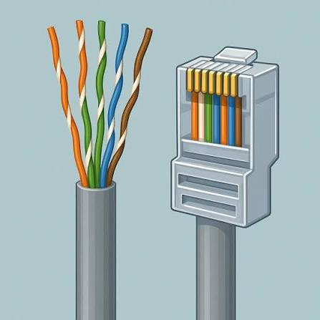
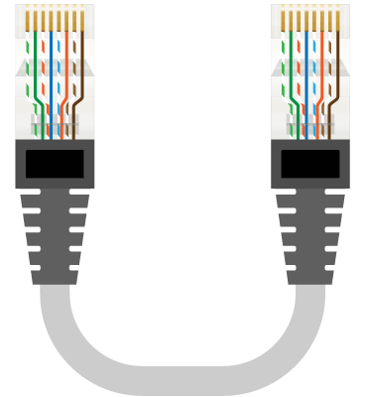
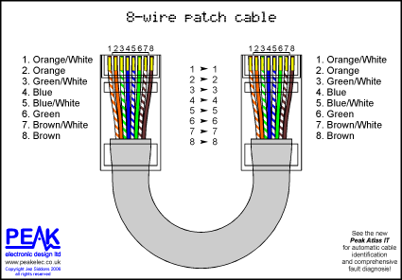
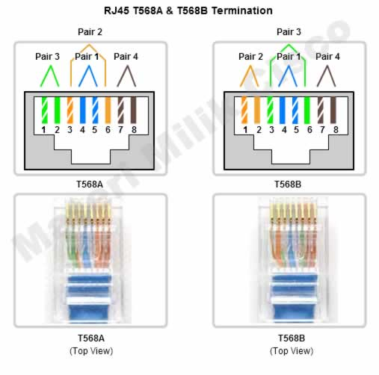
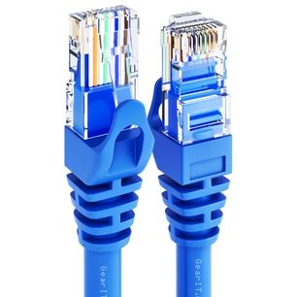
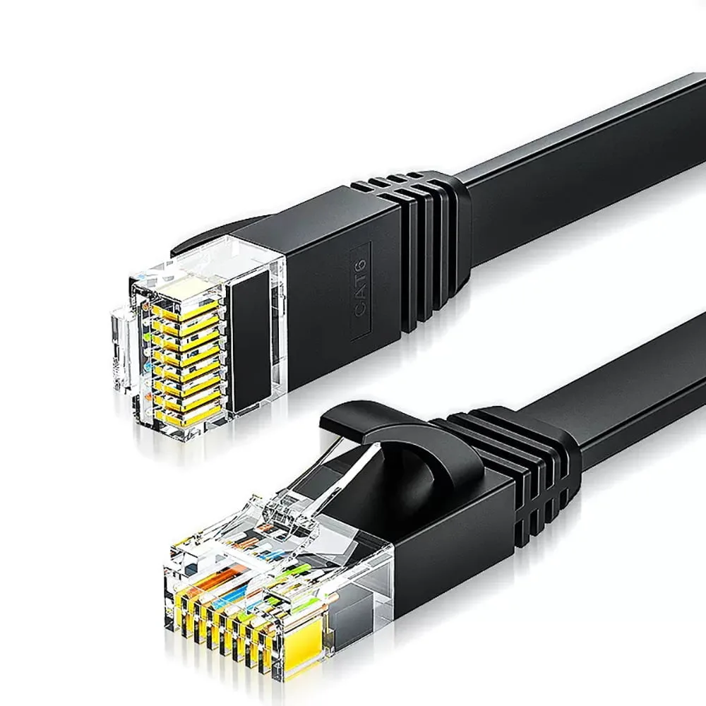
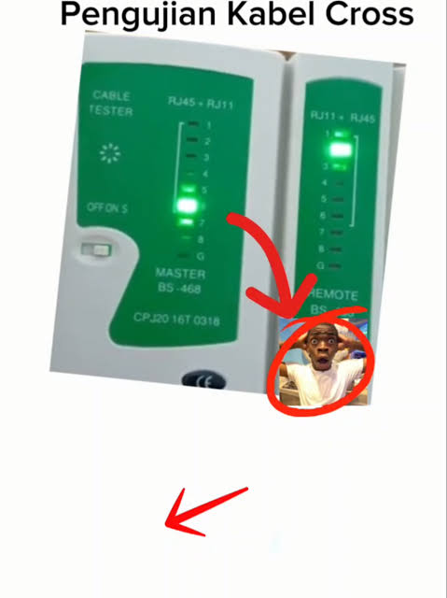

Networking
Cable
Notes:
https://networkingpeopletogether.blogspot.com/2012/01/mengenal-kabel-ethernet-cat-5.html?m=0
https://muslimpribadi.wordpress.com/2011/03/14/mengapa-pengkabelan-utp-harus-mengikuti-standar-t568a-atau-t568b/

Slide 9
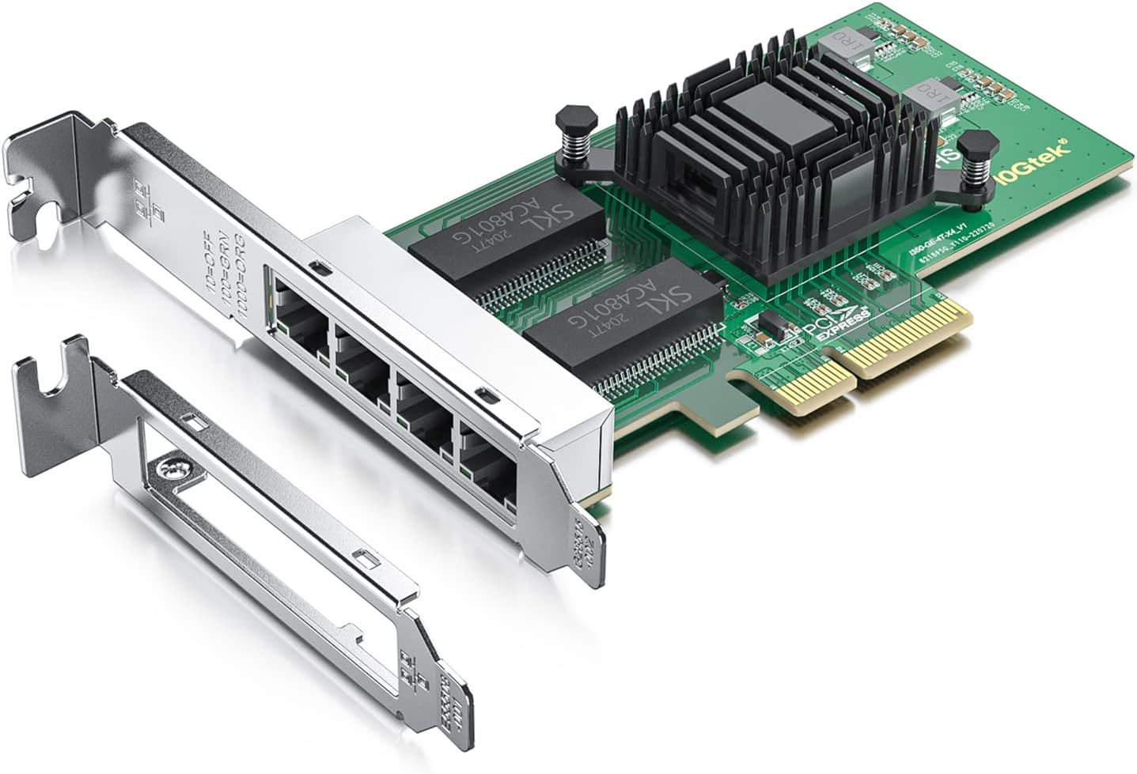
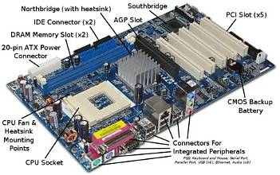
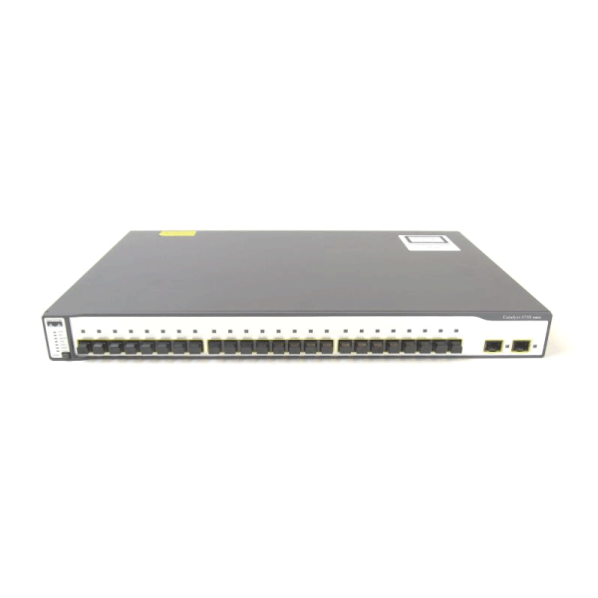
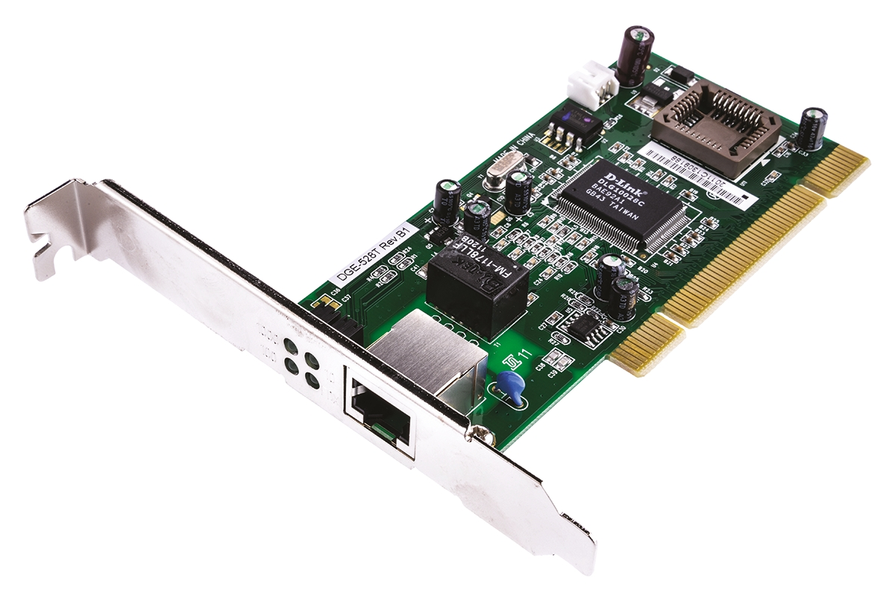

Networking
Server
Server
Switch
Client
Notes:
https://catatanteknisi.com/apa-itu-jaringan-komputer/

Slide 10
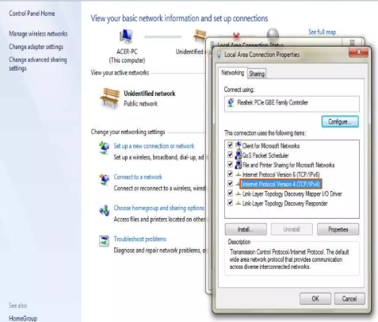
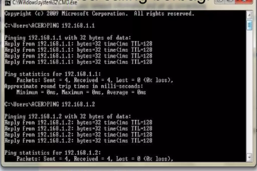
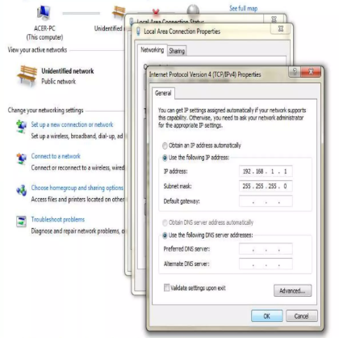
LAN

Slide 11
Networking
Server
OS : Ubuntu Server
OS : Ubuntu Server
https://www.belajarlinux.org/langkah-langkah-proses-instalasi-server-ubuntu/
DHCP, DNS Server
https://zonabiner.com/tutorial/ubuntu/konfigurasi-dhcp-server
https://setiyobudi9.wordpress.com/2012/10/05/instalasi-dan-konfigurasi-dhcp-server-pada-ubuntu/
Instalasi BIND9
https://musaamin.web.id/cara-konfigurasi-dhcp-server-di-ubuntu/
https://www.pusatcaracara.com/2021/12/cara-membuat-dhcp-server-di-linux-ubuntu.html
https://www.idn.id/konfigurasi-dns-resolver-di-linux-untuk-server/
https://zonabiner.com/konfigurasi-dns-dengan-bind-ubuntu-20-04
https://ccasp.wordpress.com/2009/12/02/install-dan-konfigurasi-dasar-dns-server-di-ubuntu/
Konfigurasi Apache di Ubuntu Server
http://www.onnocenter.or.id/wiki/index.php/Instalasi_dan_konfigurasi_Apache_di_Ubuntu_Server
Konfigurasi Web Server
https://idcloudhost.com/panduan/cara-membangun-web-server-di-ubuntu/
https://www.digitalocean.com/community/tutorials/how-to-configure-the-apache-web-server-on-an-ubuntu-or-debian-vps

Slide 12
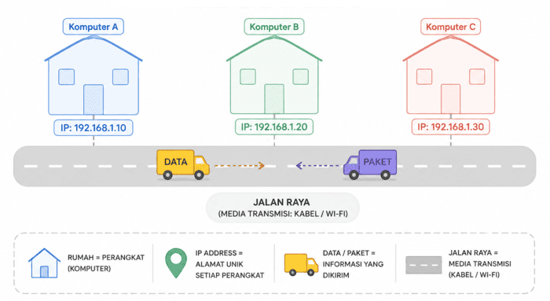
Networking
IP Address

Slide 13
CCNA
CCNA 1 -
[1] 01_Explore_the_Network
[1] 02_Configure_a_Network_Operating_System
[1] 03_Network_Protocols_and_Communication
[1] 04_Network_Access
[1] 05_Ethernet
[1] 06_Network_Layer
[1] 07_IP_Addressing
[1] 08_Subnetting_IP_Networks
[1] 09_Transport_Layer
[1] 10_Application_Layer
[1] 11_Build_a_Small_Network
CCNA 3 -
[3] 01_LAN_Design
[3] 02_Scaling_VLANs
[3] 03_STP
[3] 04_EtherChannel_HSRP
[3] 05_Dynamic_Routing
[3] 06_EIGRP
[3] 07_EIGRP_Tune
[3] 08_Single_Area_OSPF.
[3] 09_Multiarea_OSPF
[3] 10_OSPF_Tuning_Tshoot
CCNA 2 -
[2] 01_Routing_Concept
[2] 02_Static_Routing
[2] 03_Dynamic_Routing
[2] 04_Switched_Networks
[2] 05_Switch_Configuration
[2] 06_VLANs
[2] 07_Access_Control_Lists
[2] 08_DHCP
[2] 09_NAT_for_IPv4
[2] 10_Discover_Manage_Maintenance
CCNA 4
[4] 01_WAN_Concepts
[4] 02_Point-to-Point_Connections
[4] 03_Branch_Connections
[4] 04_Access_Control_Lists
[4] 05_Network_Security_and_Monitoring
[4] 06_Quality_of_Service
[4] 07_Network_Evolution
[4] 08_Network_Troubleshooting

Slide 14
Link CCNA Module Cisco Academic
Jaringan Komputer
CCNA 1 v7: https://github.com/amelcharolinesgn2/CCNA-1-v7
CCNA 2 v7: https://github.com/amelcharolinesgn2/CCNA-2-v7
Antar Jaringan
CCNA 3 v7: https://github.com/amelcharolinesgn2/CCNA-3-v7
CCNA 4 v7: https://github.com/amelcharolinesgn2/CCNA-4-v7

Slide 15
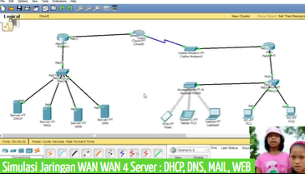
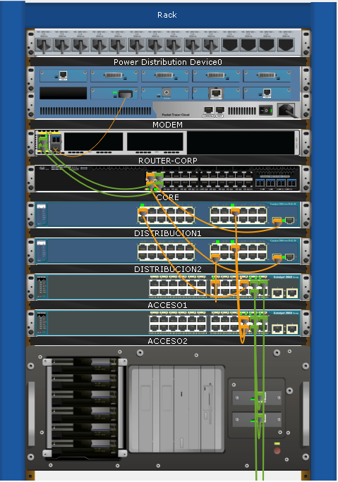
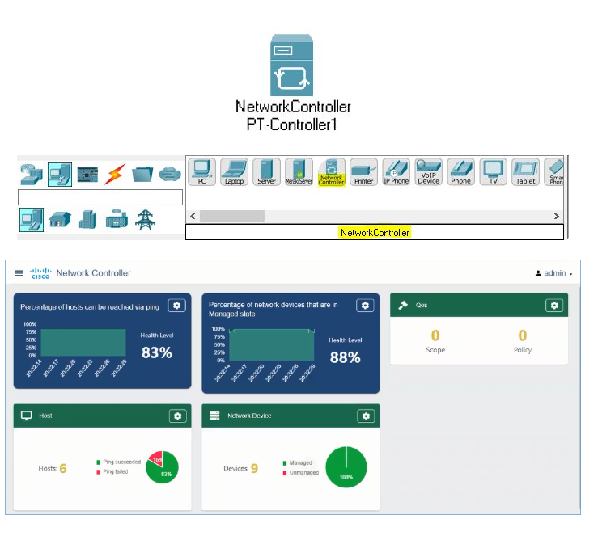
Jaringan WAN 4 Server DNS, WEB, MAIL, DHCP - Cisco Packet Tracer

Slide 16



https://github.com/siagianp
https://www.youtube.com/@AmelOline/videos
https://github.com/amelcharolinesgn2/IoT_simulator-mqtt-NodeRed
https://github.com/amelcharolinesgn2/Cloud-Infrastructures
https://github.com/amelcharolinesgn2/ClouD-Infrastructure-SISKA-2025
https://github.com/amelcharolinesgn2/Gyroscope-Sensor-Data-Accelerometer

